Slide 1
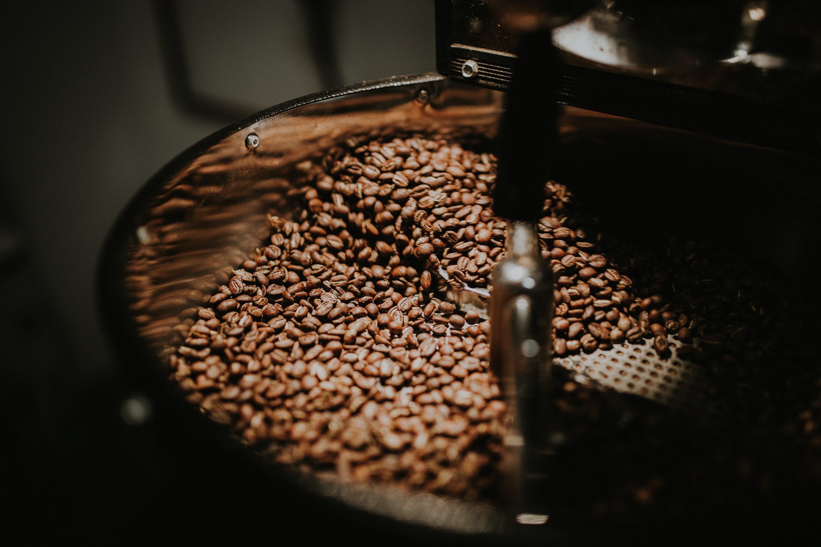
COFFEE QUALITY DATASET
Presented by:
Vaishnavi V

Slide 2
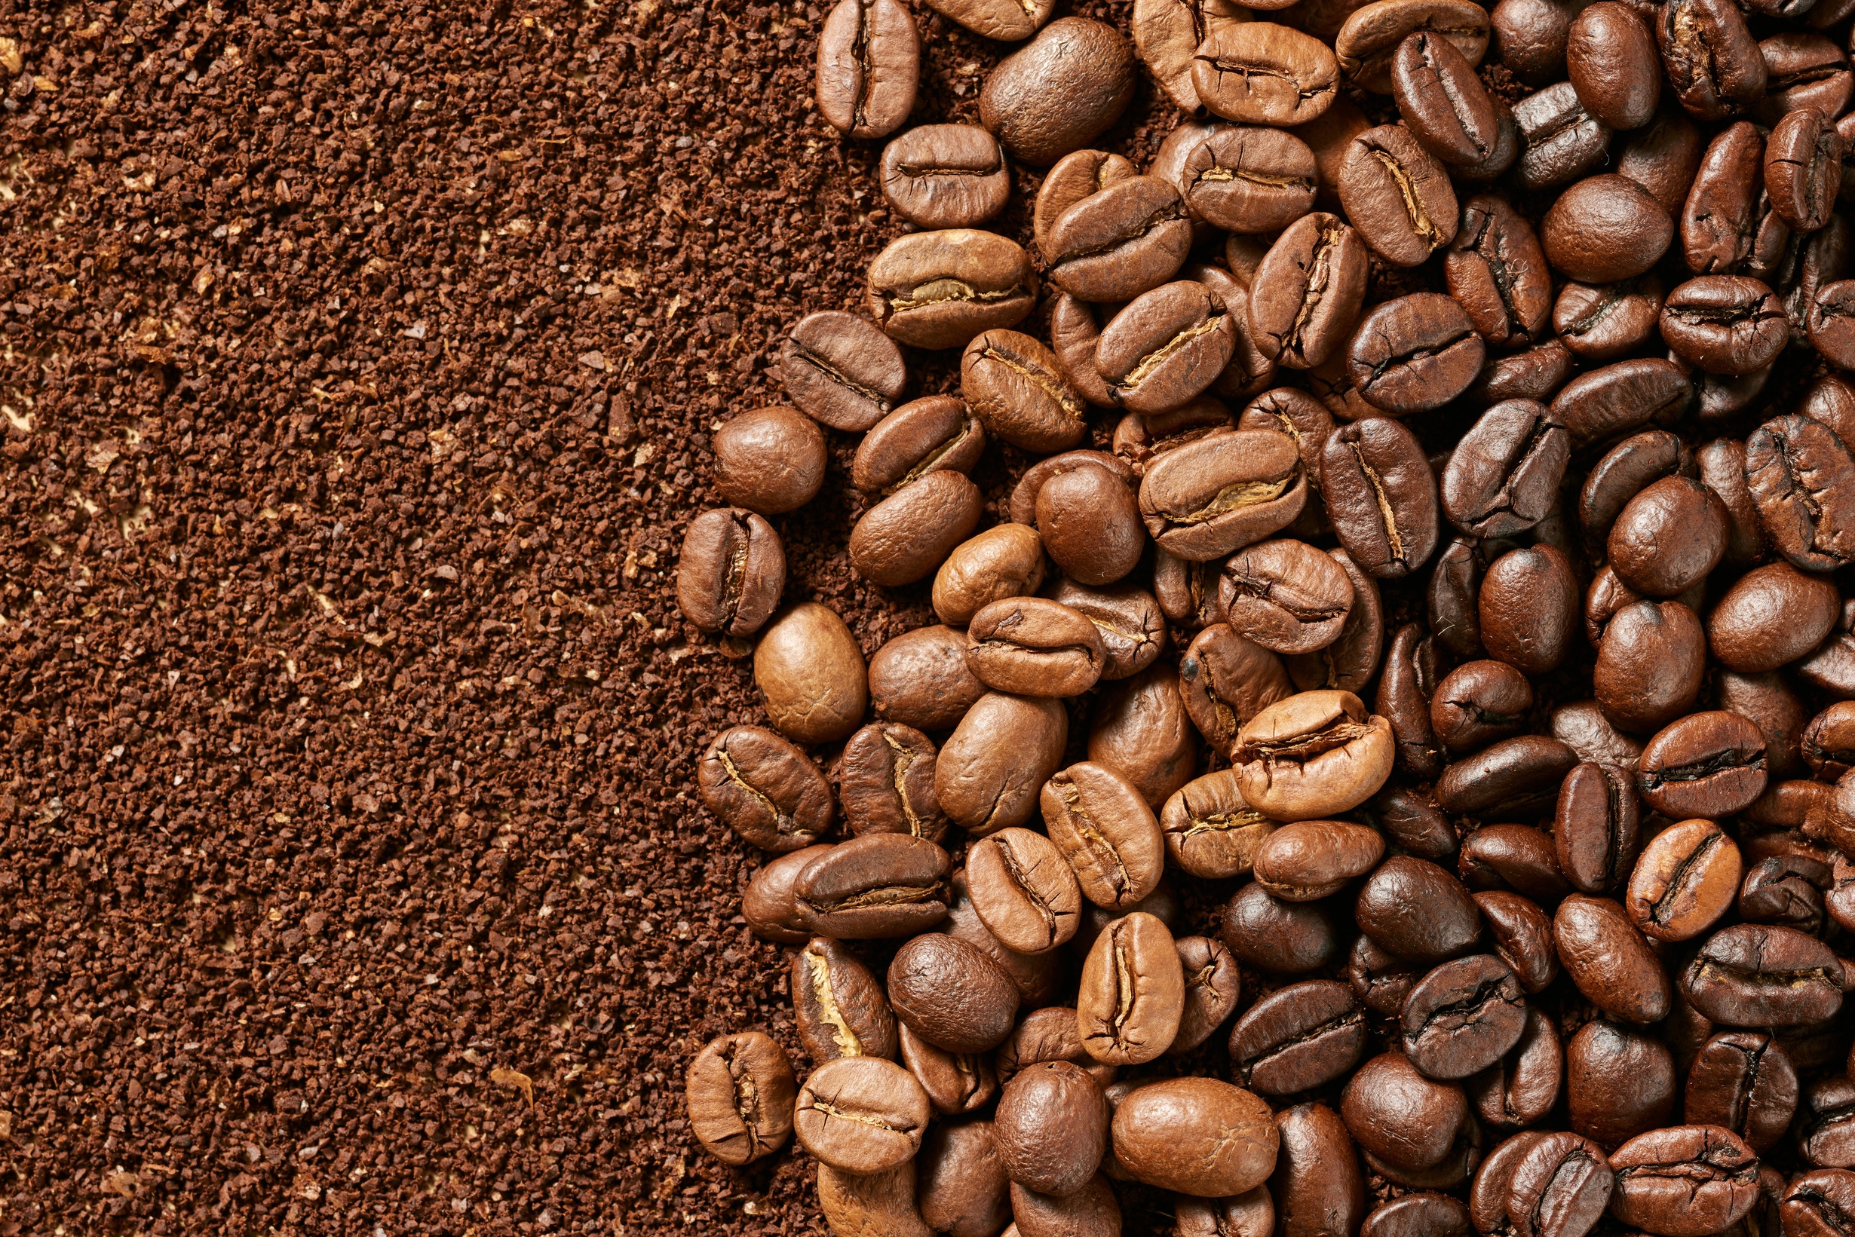
OBJECTIVE
The objective of this analysis is to comprehensively explore and understand the coffee quality dataset in order to identify the key factors that influence overall coffee quality. This includes examining the relationship between sensory, physical, and geographical attributes. The analysis aims to uncover patterns, trends, and variations within the data, segment coffees into meaningful quality groups, and generate actionable insights that can support better decision-making for coffee producers, exporters, buyers, and quality evaluators in improving cultivation practices, enhancing product consistency, and optimizing market positioning.

Slide 3

DATA UNDERSTANDING
This database contains the following information:
Quality Measures: Aroma, Flavor, Aftertaste, Acidity, Body,
Balance,Color, Sweetness, Clean.Cup, Uniformity,
Cupper.Points, Total.Cup.Points
Bean Metadata: Moisture, Category.One.Defects, Category.Two.Defects,
Quakers, Number.of.Bags
Farm Metadata: Country.of.Origin, Region, Farm.Name, Owner,
Company, Variety, Processing.Method, Species, Mill

Slide 4
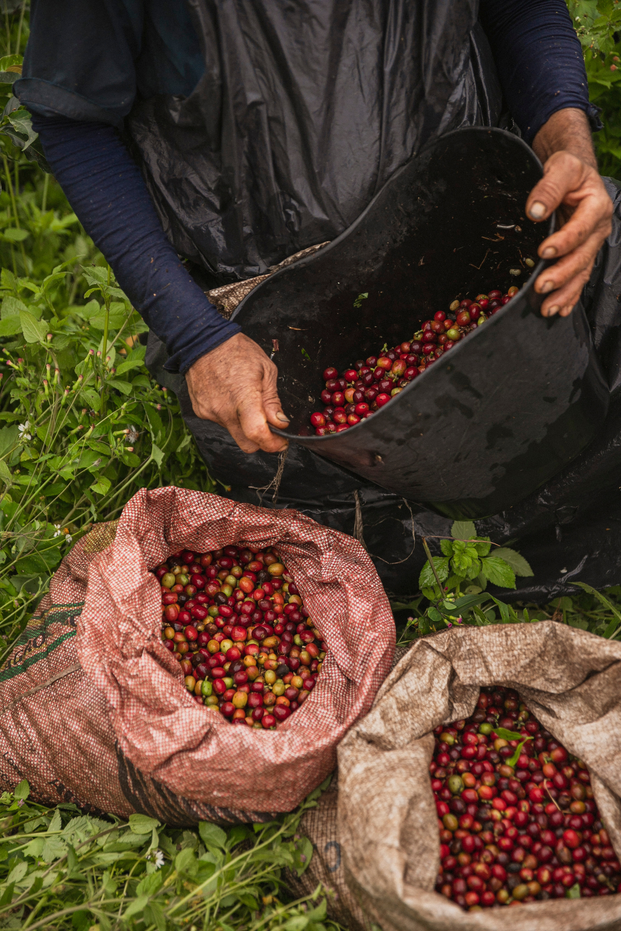
DATA CLEANING
Found out the percentage of missing values in each column corresponding to total number of records.
Dropped the column , which not useful for the analysis.
Found out the unique values of each columns in the dataframe.
Handled missing values by either filling or dropping them.

Slide 5
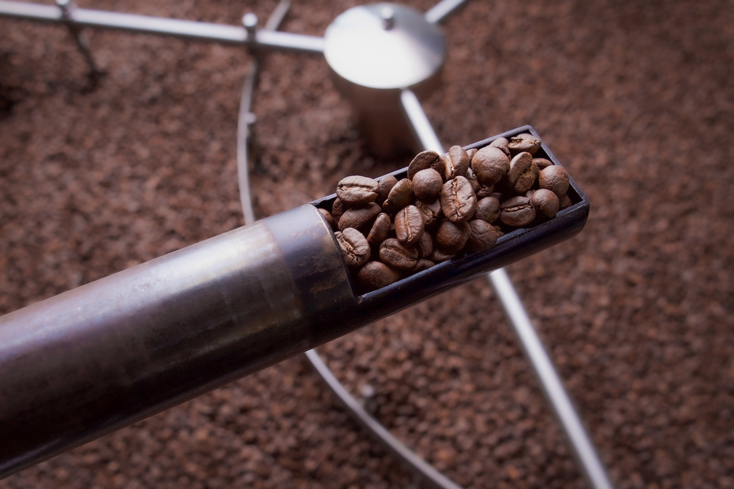


TOOLS USED
PYTHON- Used for data understanding , cleaning, analysis and visualization
PANDAS- It is an open-source python library for data analysis, data structures and manipulation
NUMPY-Mathematical and scientific computing library
MATPOTLIB- Create animated and interactive visualizations
SEABORN- Create attractive and informative statistical graphics

Slide 6

DESCRIPTIVE ANALYSIS
===== SUMMARY STATISTICS : QUALITY MEASURES ===== Aroma Flavor Aftertaste Acidity Body Balance \ count 614.000000 614.000000 614.000000 614.000000 614.000000 614.000000 mean 7.650651 7.499463 7.360440 7.511173 7.475537 7.472036 std 2.429667 0.309046 0.319755 0.288097 0.268414 0.327335 min 6.330000 6.170000 6.170000 6.250000 6.330000 6.080000 25% 7.420000 7.330000 7.170000 7.330000 7.330000 7.250000 50% 7.580000 7.500000 7.420000 7.500000 7.500000 7.500000 75% 7.750000 7.670000 7.580000 7.670000 7.670000 7.670000 max 67.350000 8.670000 8.500000 8.580000 8.420000 8.580000 Sweetness Clean.Cup Uniformity Cupper.Points Total.Cup.Points count 614.000000 614.000000 614.000000 614.000000 614.000000 mean 9.902020 9.855489 9.857590 7.444479 81.931580 std 0.524423 0.683464 0.476425 0.403747 2.659006 min 1.330000 1.330000 6.000000 5.170000 59.830000 25% 10.000000 10.000000 10.000000 7.250000 81.080000 50% 10.000000 10.000000 10.000000 7.500000 82.330000 75% 10.000000 10.000000 10.000000 7.670000 83.330000 max 10.000000 10.000000 10.000000 8.580000 89.920000

Slide 7


===== SUMMARY STATISTICS : BEAN METADATA ===== Moisture Category.One.Defects Category.Two.Defects Quakers \ count 614.000000 614.000000 614.000000 614.000000 mean 0.098306 0.368078 3.382736 0.216612 std 0.037652 2.264995 5.134259 0.910507 min 0.000000 0.000000 0.000000 0.000000 25% 0.100000 0.000000 0.000000 0.000000 50% 0.110000 0.000000 2.000000 0.000000 75% 0.120000 0.000000 4.000000 0.000000 max 0.170000 31.000000 47.000000 11.000000 Number.of.Bags count 614.000000 mean 178.879479 std 214.958432 min 1.000000 25% 20.000000 50% 250.000000 75% 275.000000 max 3200.000000

Slide 8
===== FARM METADATA COUNTS ===== Country.of.Origin Region Farm.Name Owner count 614 614 614 614 unique 28 205 326 154 top Guatemala oriente various juan luis alvarado romero freq 146 65 37 134 Company Variety Processing.Method Species count 614 614 614 614 unique 179 22 5 2 top unex guatemala, s.a. Bourbon Washed / Wet , Arabica freq 73 165 448 611 Mill count 614 unique 279 top beneficio ixchel freq 76

Slide 9

ANALYSIS PERFORMED
The analysis focused on exploring and understanding the Coffee Quality dataset to identify the factors influencing overall coffee quality.
Exploratory Data Analysis (EDA) was then performed using visualizations such as histograms, box plots, bar charts, and correlation heatmaps to understand the distribution of sensory attributes and their relationship with Total Cup Points.
Statistical analysis was used to examine the impact of key sensory features including aroma, flavor, acidity, body, balance, sweetness, and aftertaste on quality scores. Comparisons were also made across countries, processing methods, and species (Arabica vs Robusta) to observe variations in coffee performance.

Slide 10
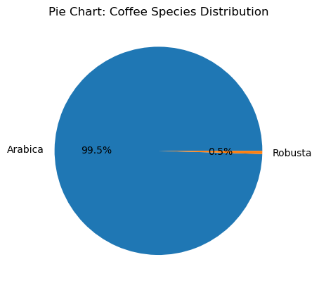
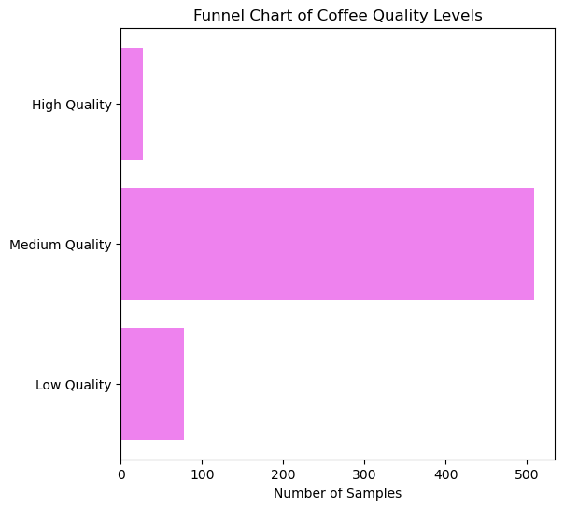
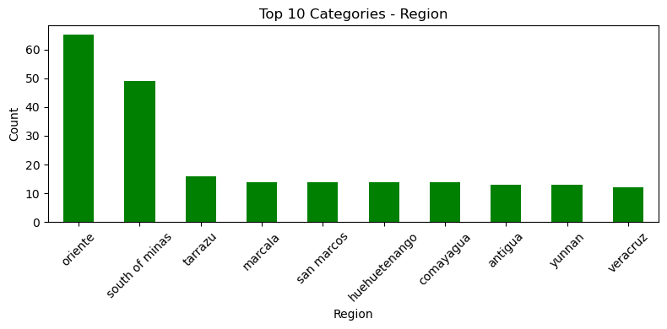
UNIVARIATE ANALYSIS

Slide 11
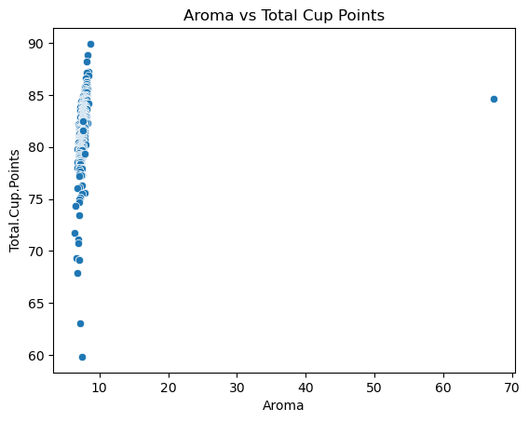
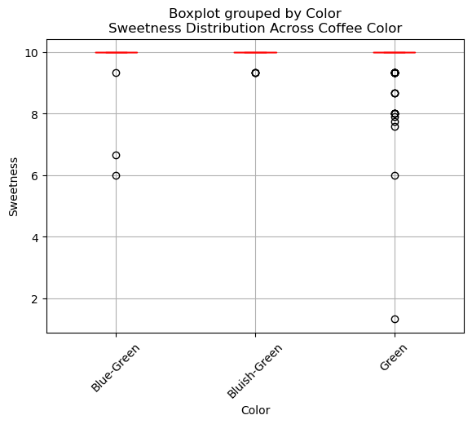
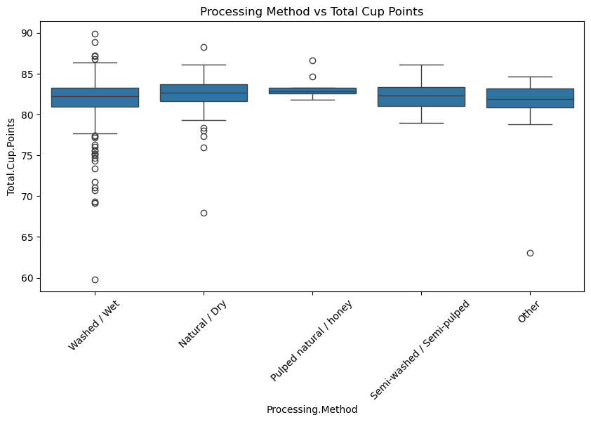
BIVARIATE ANALYSIS

Slide 12
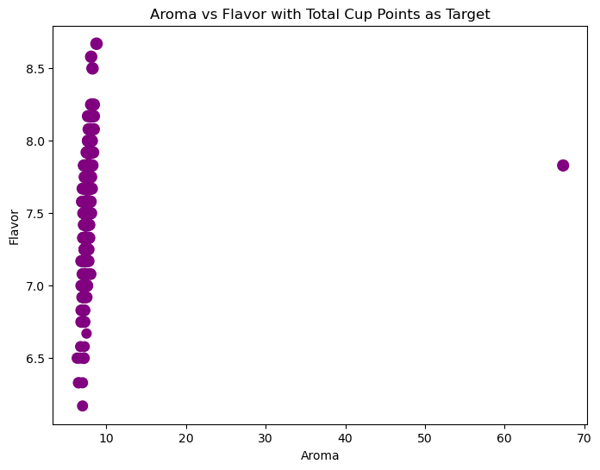
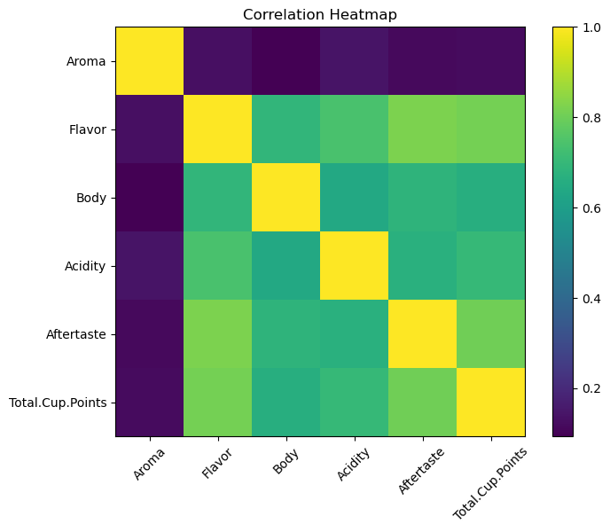
MULTIVARIATE ANALYSIS

Slide 13
KEY INSIGHTS
Aroma, Flavor, Balance, and Aftertaste show the strongest correlation with Total Cup Points.
Coffees scoring above 85 consistently show:
Higher Aroma and Flavor
Better Balance and Sweetness
Low-quality coffees exhibit weaker sensory consistency.
Certain countries consistently produce higher average quality scores.
Quality varies significantly among countries, indicating the importance of terroir and farming practices.
Washed and Honey processing methods tend to generate higher average cup points.
Natural processing shows greater variability in quality.
Premium coffees with high sensory scores
Medium-standard coffees
Low-scoring coffees with poor sensory balance

Slide 14

RECOMMENTATIONS
Focus on improving Aroma and Flavor development through better roasting and fermentation control.
Adopt processing methods like Washed or Honey for higher consistency in quality.
Monitor Balance and Aftertaste during quality control.
Use high-impact features (Aroma, Flavor, Sweetness) as primary evaluation metrics.
Apply clustering results to classify coffee lots into quality tiers earl
Integrate predictive models to estimate Total Cup Points from sensory scores.
Use this dataset for seasonal trend and terroir analysis.
Prioritize sourcing from high-performing countries and farms identified in analysis.
Market premium clusters as specialty-grade coffee.

Slide 15
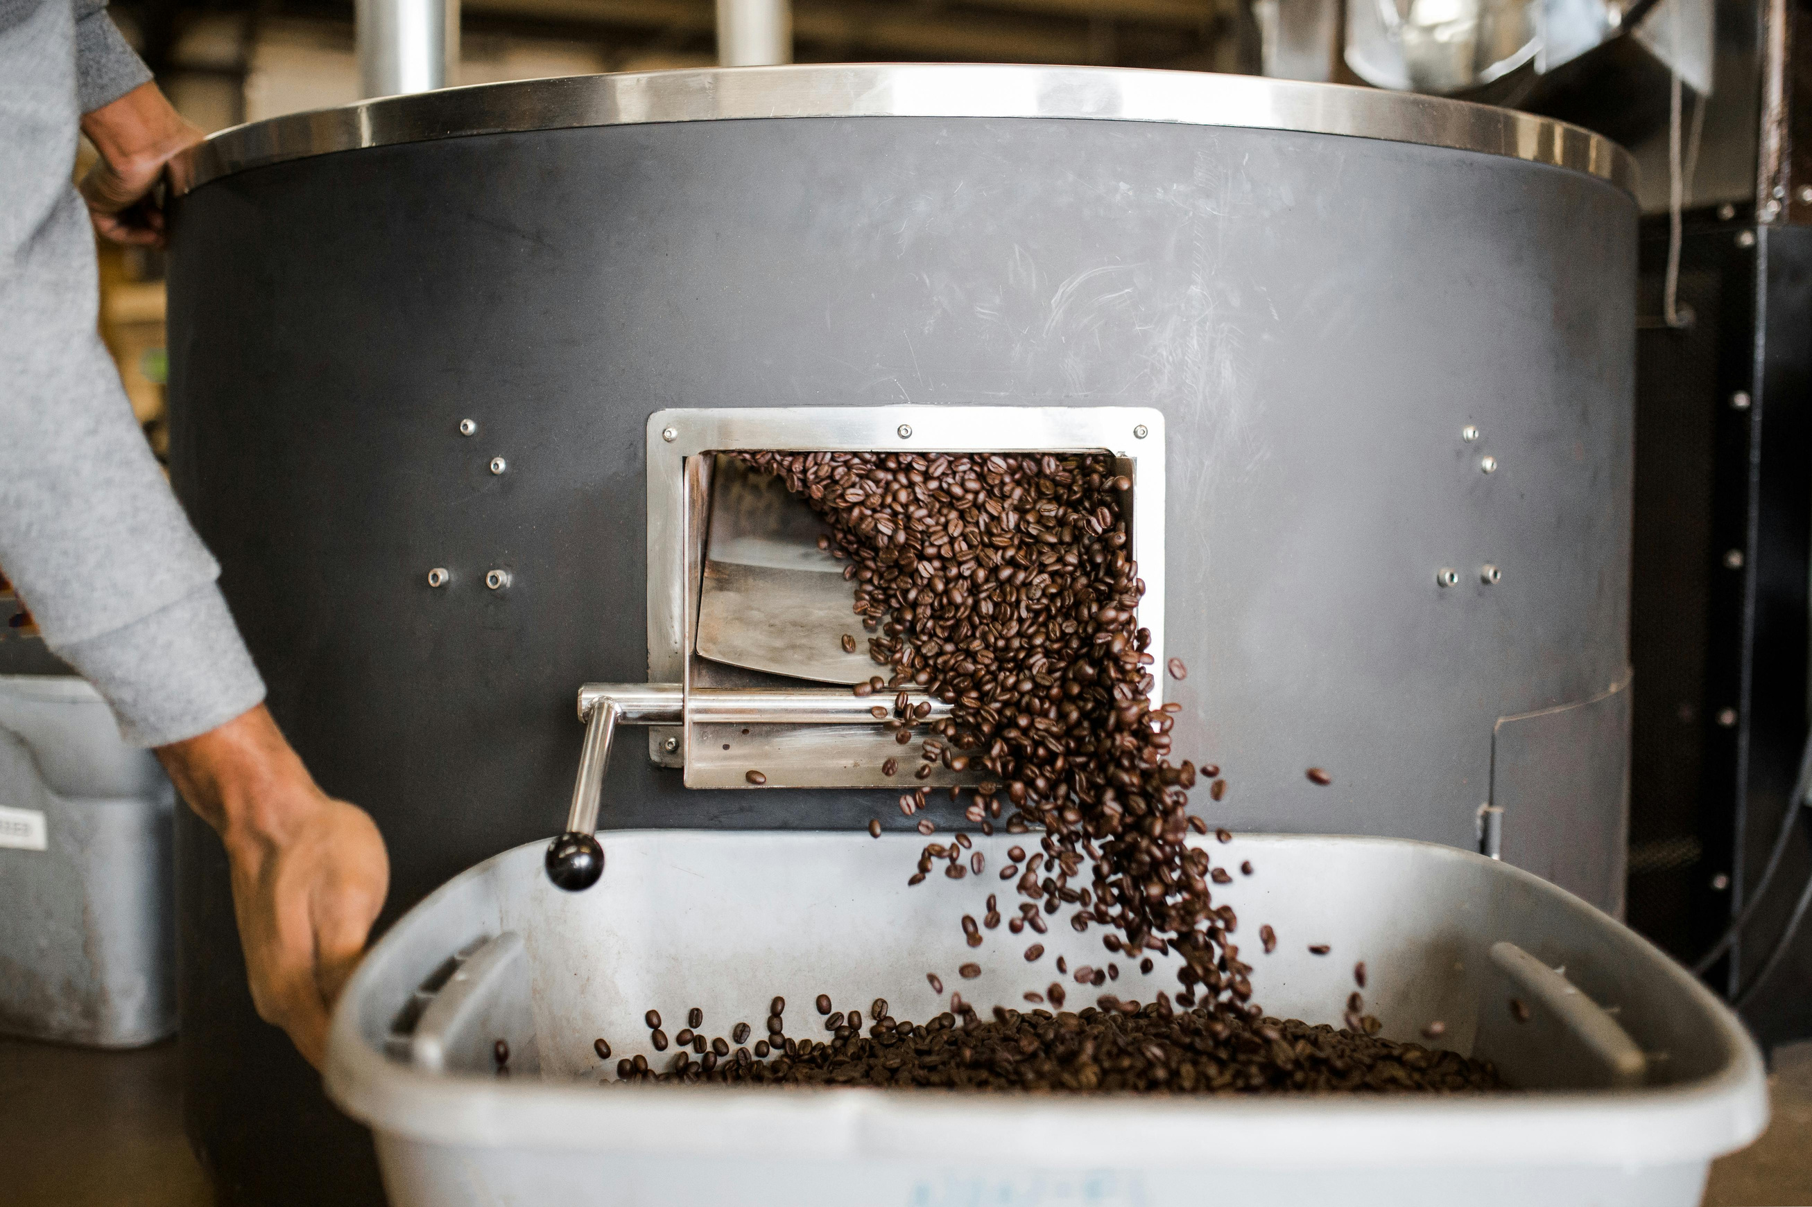
CONCLUSION
The analysis shows that coffee quality mainly depends on sensory features like aroma, flavor, and balance, as well as the processing methods used. By paying more attention to these factors, producers can improve the overall quality of coffee, increase its market value, and support sustainable production. Using data-based insights helps everyone involved, from farmers to sellers, make better decisions throughout the coffee production process.

Slide 16
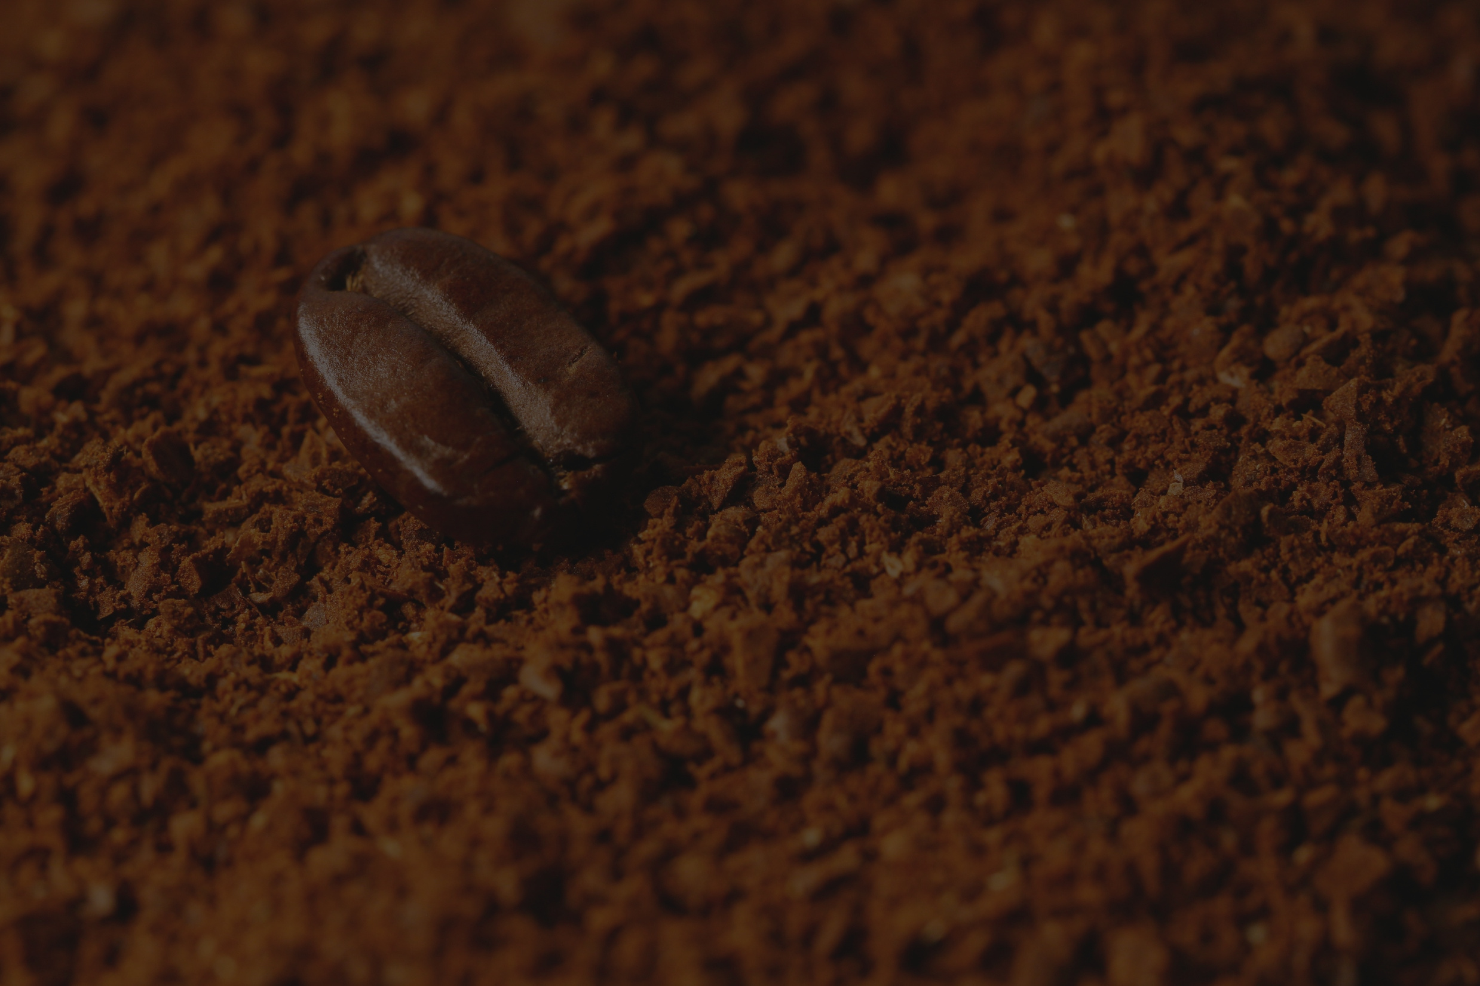
Thank You
For Your Attention

